Slide 1
Two-Way Real-Time Sign Language Recognition
Dhruvil Mehta - dm1610
Harish Balasubramaniam- hb425
Nisarg Shah - ns1452
Niyati Jain - nsj39
Sarthak Dalal - spd115

Slide 2
What is the problem you are solving?
Currently, 1.5 billion people in the world suffer from partial hearing loss and more than 430 million people have complete hearing loss.
Their only means of communication is Sign Language.
Sign Language recognition (SLR) is a process that uses technology to recognize what the specially-abled person is saying by identifying the signs and hand gestures and returning the output in the form of text or speech.
However, SLR systems are usually trained on just one sign language system. What if a deaf person from the United States who communicates using the American Sign Language(ASL) System wanted to communicate with a deaf person from India who communicates using the Indian Sign Language(ISL) System? They would not understand each other’s sign languages.

Slide 3
Project objective:
Develop a two-way real-time sign language recognition tool that can recognize signs from both the American and Indian Sign Language in real time and help facilitate a conversation between the specially abled from two different countries

Slide 4
Problem Setting
The program would first ask the user whether he/she wishes to use the ASL or the ISL.
A real time sign language recognition tool would use a front camera for capturing the signs the user is making and the ML algorithm would translate the signs in real time to text which would be displayed on the screen.
The displayed text can also be converted to speech using text-to-speech.
For the purpose of this project we plan on converting just the numbers (0-9) and the letters (A-Z) from sign language to text in both the sign language systems.
We would be using the python programming language and training a convolutional neural network (CNN) to make this possible.

Slide 5
Input of the model
70 images of each character for ASL were taken. Each of them were rotated and total 140 images of each character were used for validation and training
70 images of each character for ISL were taken. Each of them were rotated and total 140 images of each character were used for validation and training.
For both the models, 11/12th of the images were used for training and the rest (1/12th) were used for validation.

Slide 6
Methodology
Step 1: Skin Detection by Histogram Backprojection
A histogram that contains the number of pixels for each possible value of pixel was created for a sample image to identify the skin color
Step 2: Hand Segmentation using the OpenCv library
Hand segmentation is the process of isolating the hand from the background in an image or video.
A series of preprocessing methods from the openCV library like blurring, thresholding etc gave an end result of gray scale images with inverted colors.
Step 3: Standardization via Rotation
Each image is rotated 180 degrees in order to standardize the orientation of the hands for analysis and processing.
Step 4: Training
The final images are then split into training and testing data for predictive modelling via Convolutional Neural Networks(CNN).

Slide 7
Convolutional Neural Network
A Convolutional Neural Network (CNN) is a deep learning algorithm that has been used extensively for image classification tasks. It is a type of neural network that has been designed specifically for analyzing visual imagery, and it has proven to be highly effective in identifying patterns and features in images.
The main advantage of using a CNN model for image classification is its ability to automatically learn relevant features from the input data. This is done through the use of convolutional layers that scan the input image with a set of learned filters. These filters detect different patterns and features in the image, such as edges, corners, and textures. The output of these convolutional layers is then passed through pooling layers that reduce the dimensionality of the data, making it easier to process. The resulting features are then fed into fully connected layers that perform the final classification.

Slide 8
Implementation of ML Model
We run the preprocessed images through the Convolutional Neural Network model that we built.
Our model has 3 convolutional layers, each of which is followed by a MaxPooling layer.
Finally, we use 2 Dense layers and a Dropout layer, and the final layer predicts the output.
This model is then saved, which is used for predicting real time output, given a real-time input video stream.

Slide 9
Architecture of CNN
We run the preprocessed images through the Convolutional Neural Network model that we built.
Our model has 3 convolutional layers, each of which is followed by a MaxPooling layer.
We then pass the flattened array Z through 2 dense layers, with dimensions (m1, ) and (m2, ), respectively, where m1 and m2 are the number of neurons in each layer. We apply a Dropout layer to the output of the second dense layer, with a dropout rate of d, to prevent overfitting.
Finally, we pass the output of the Dropout layer through the final output layer, which uses a softmax activation function to predict the class probabilities of the input image X belonging to each of the different hand gesture categories.

Slide 10
GRAPHS FOR ASL

Slide 11
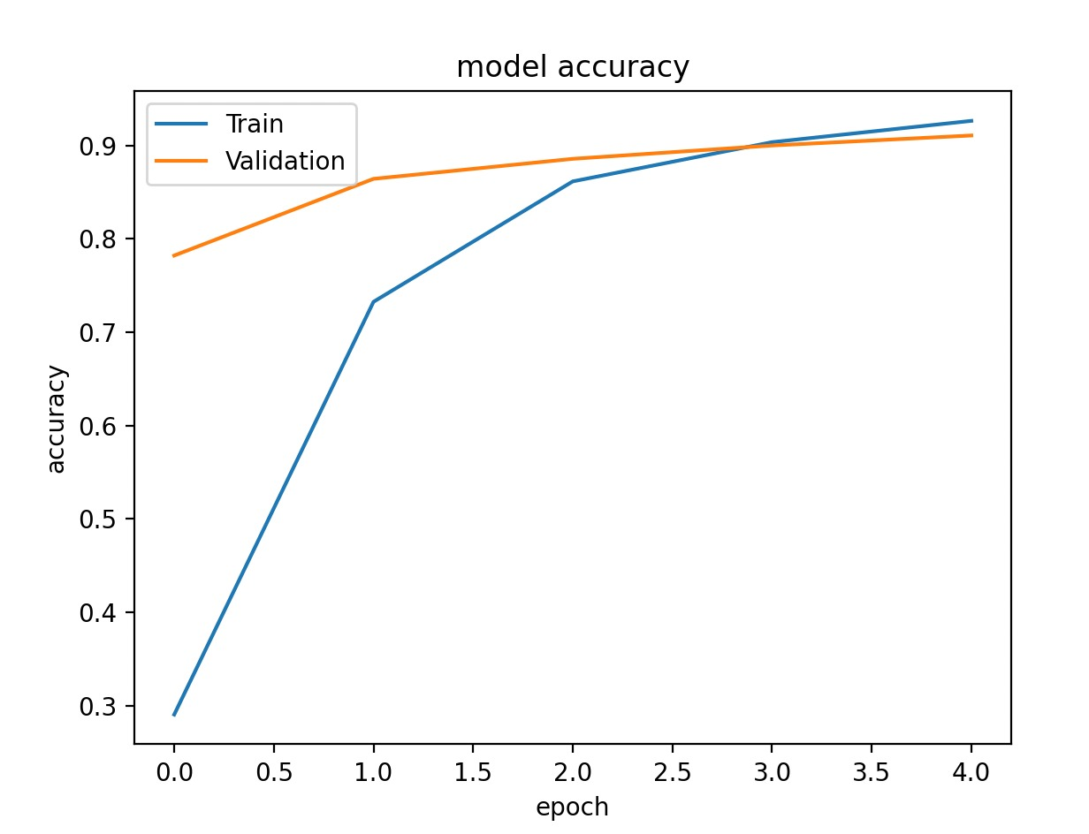
Accuracy Curve

Slide 12
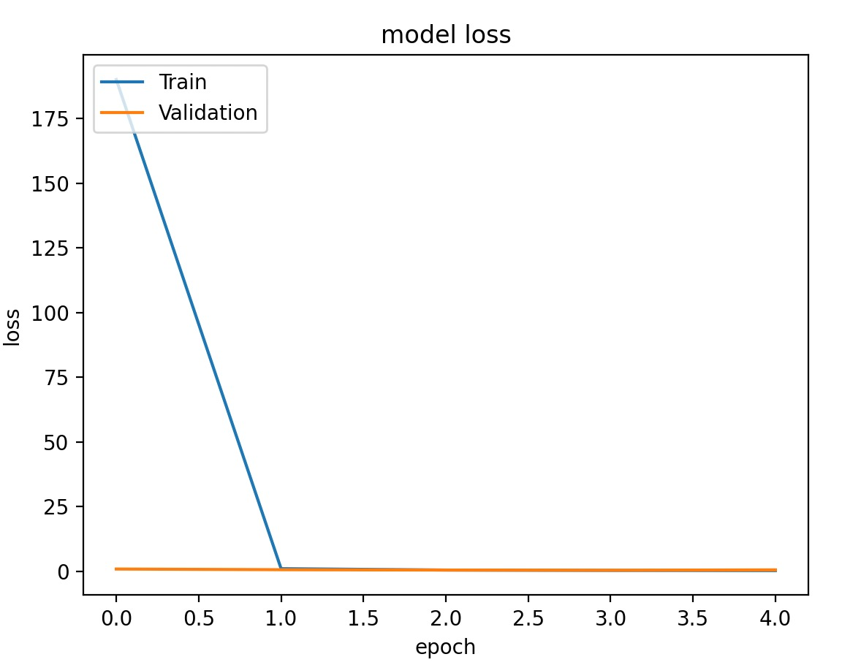
Loss Curve

Slide 13
GRAPHS FOR ISL

Slide 14
Accuracy Curve for ASL

Slide 15
Loss Curve for ASL

Slide 16
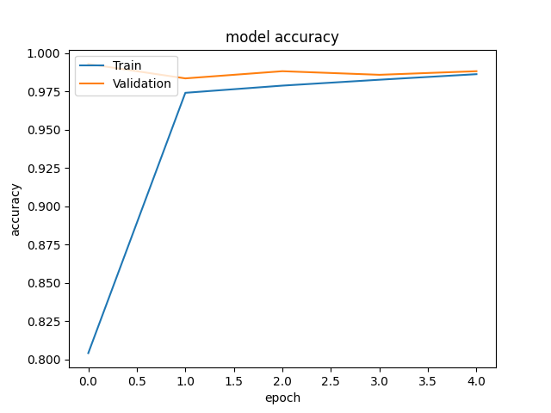
Accuracy Curve for ISL

Slide 17
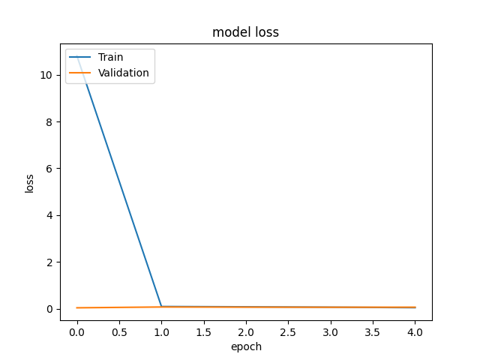
Loss Curve for ASL

Slide 18
Understanding Datasets
Dataset for ASL Link - https://www.kaggle.com/datasets/ayuraj/asl-dataset
This dataset consists of American Sign Language images of letters and numbers in their respective folders with close to 70 images for each sign.
Dataset for ISL Link - https://www.kaggle.com/datasets/prathumarikeri/indian-sign-language-isl
This dataset consists of Indian Sign Language images of letters and numbers in their respective folders with close to 1200 images for each sign. We took out 70 images for each sign as due to hardware limitations, it would take a lot of time to train the data if we had utilized the entire dataset.

Slide 19
Results
For the ASL, after training the model, we get a training accuracy of approximately 93% and a validation accuracy of approximately 91%.
For the ISL, after training the model, we get a training accuracy of approximately 98% and a validation accuracy of approximately 98%.

Slide 20
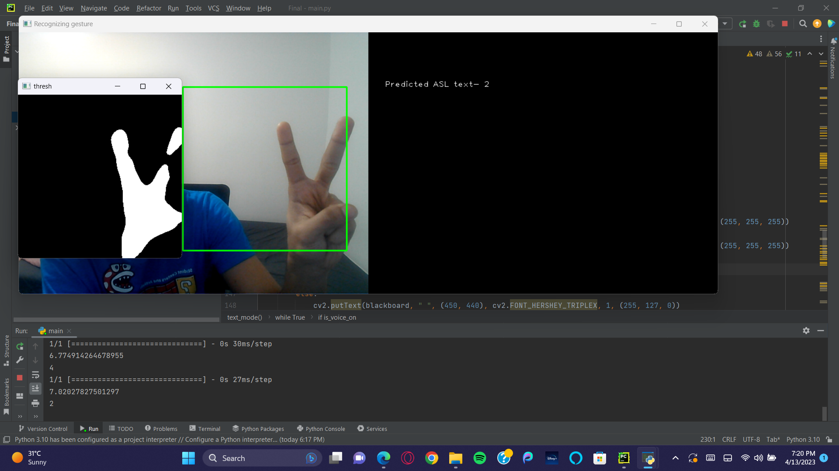
Output - ASL - Number 2

Slide 21
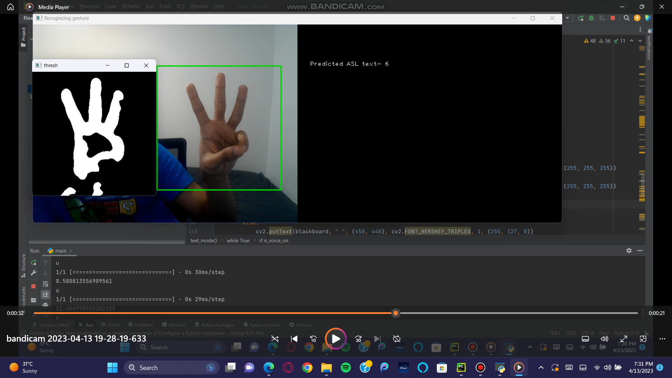
Output - ASL - Number 6

Slide 22
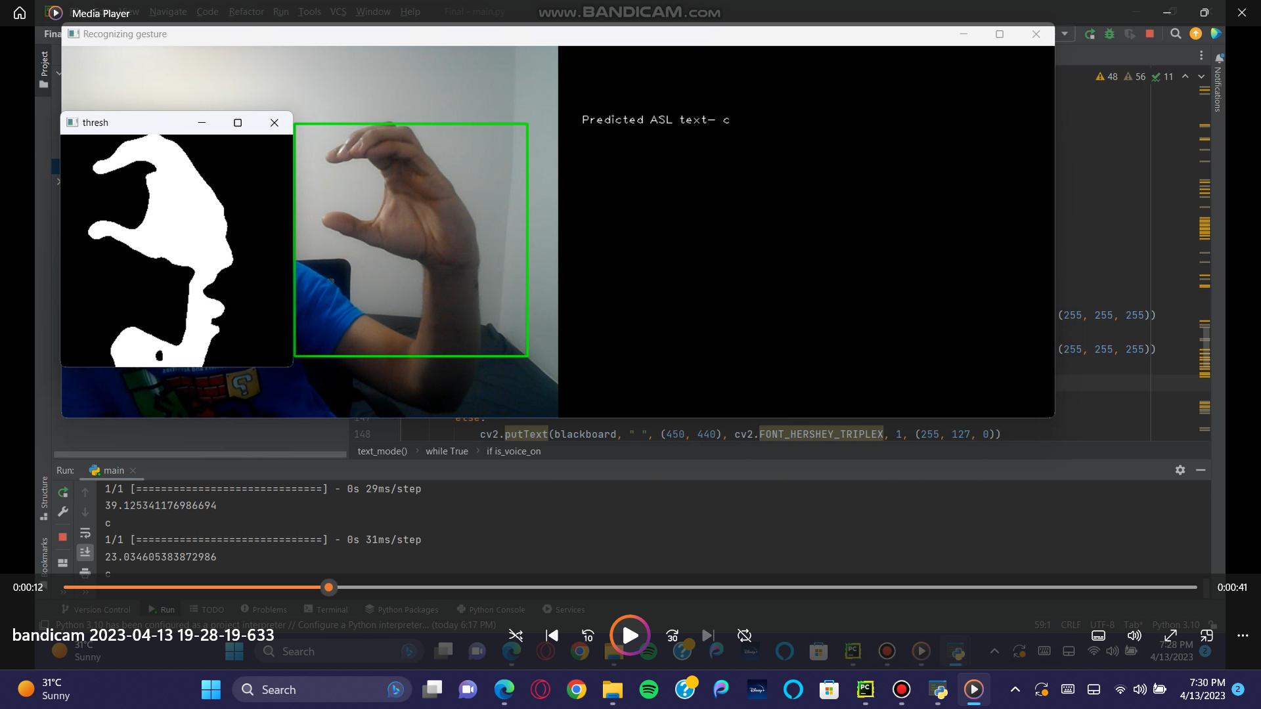
Output - ASL - Letter c

Slide 23
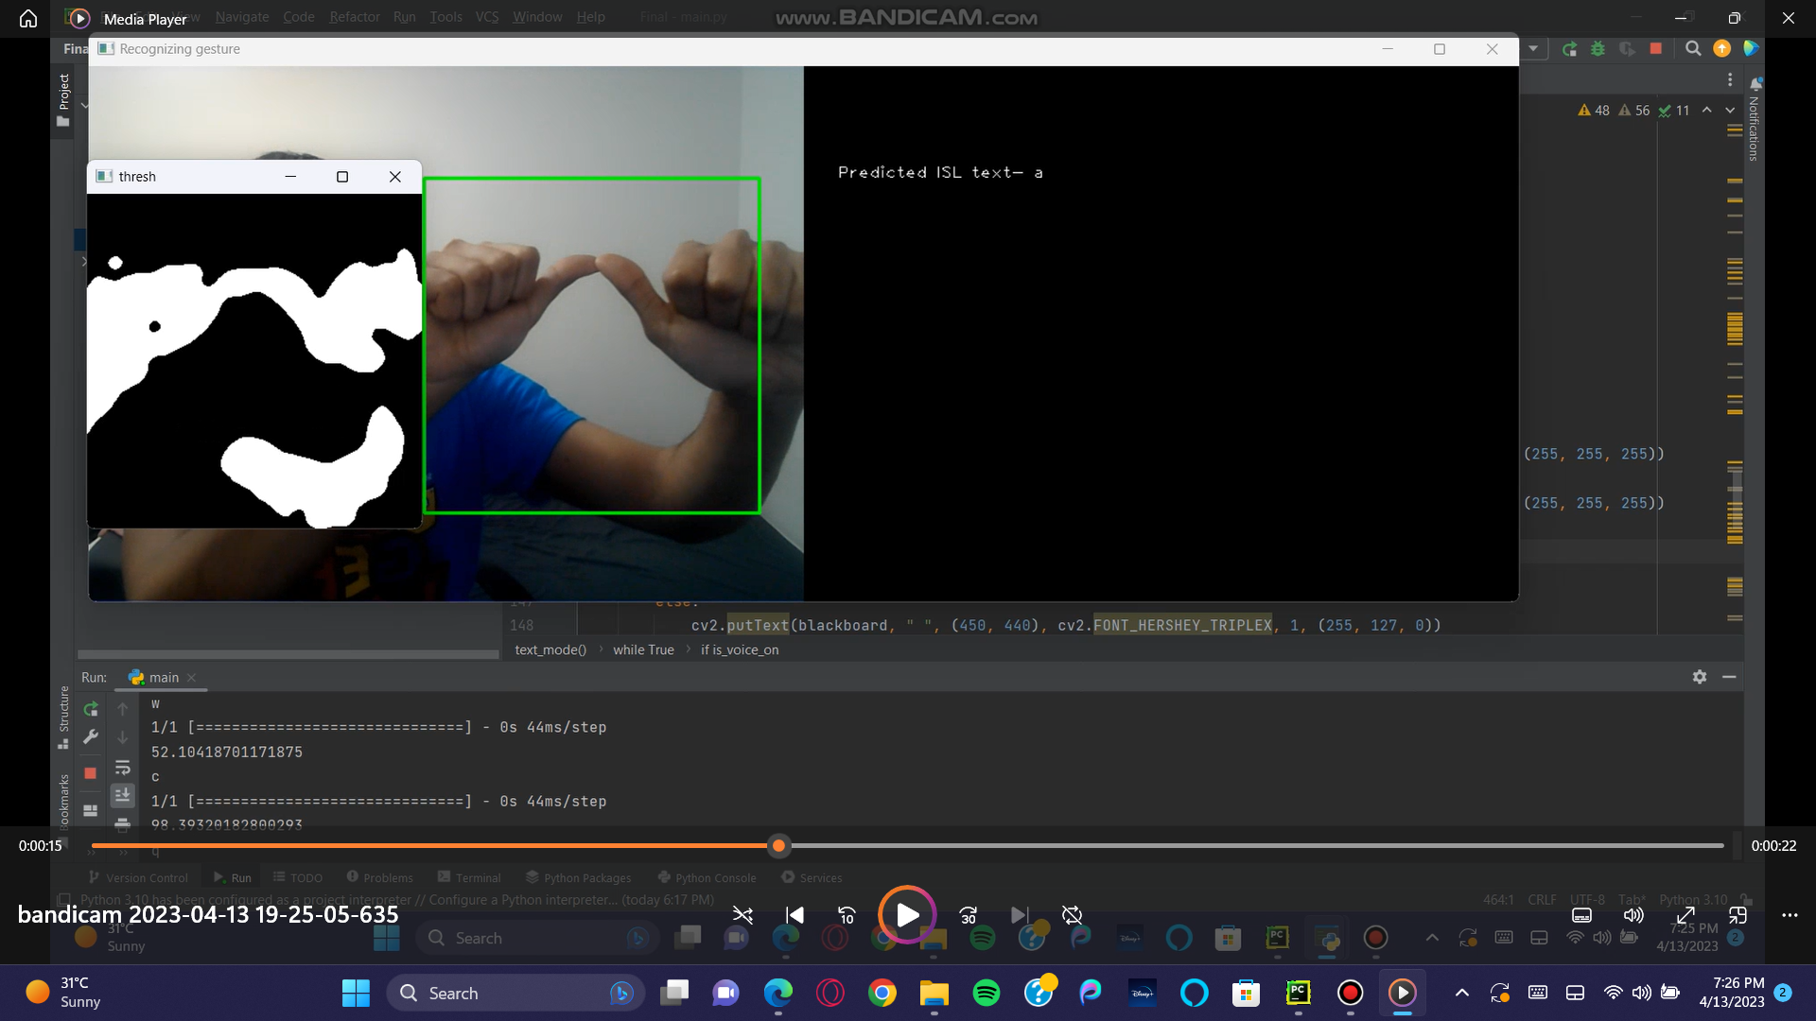
Output - ISL - Letter a

Slide 24
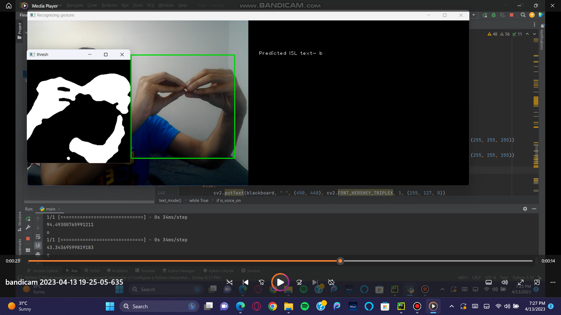
Output - ISL - Letter b

Slide 25
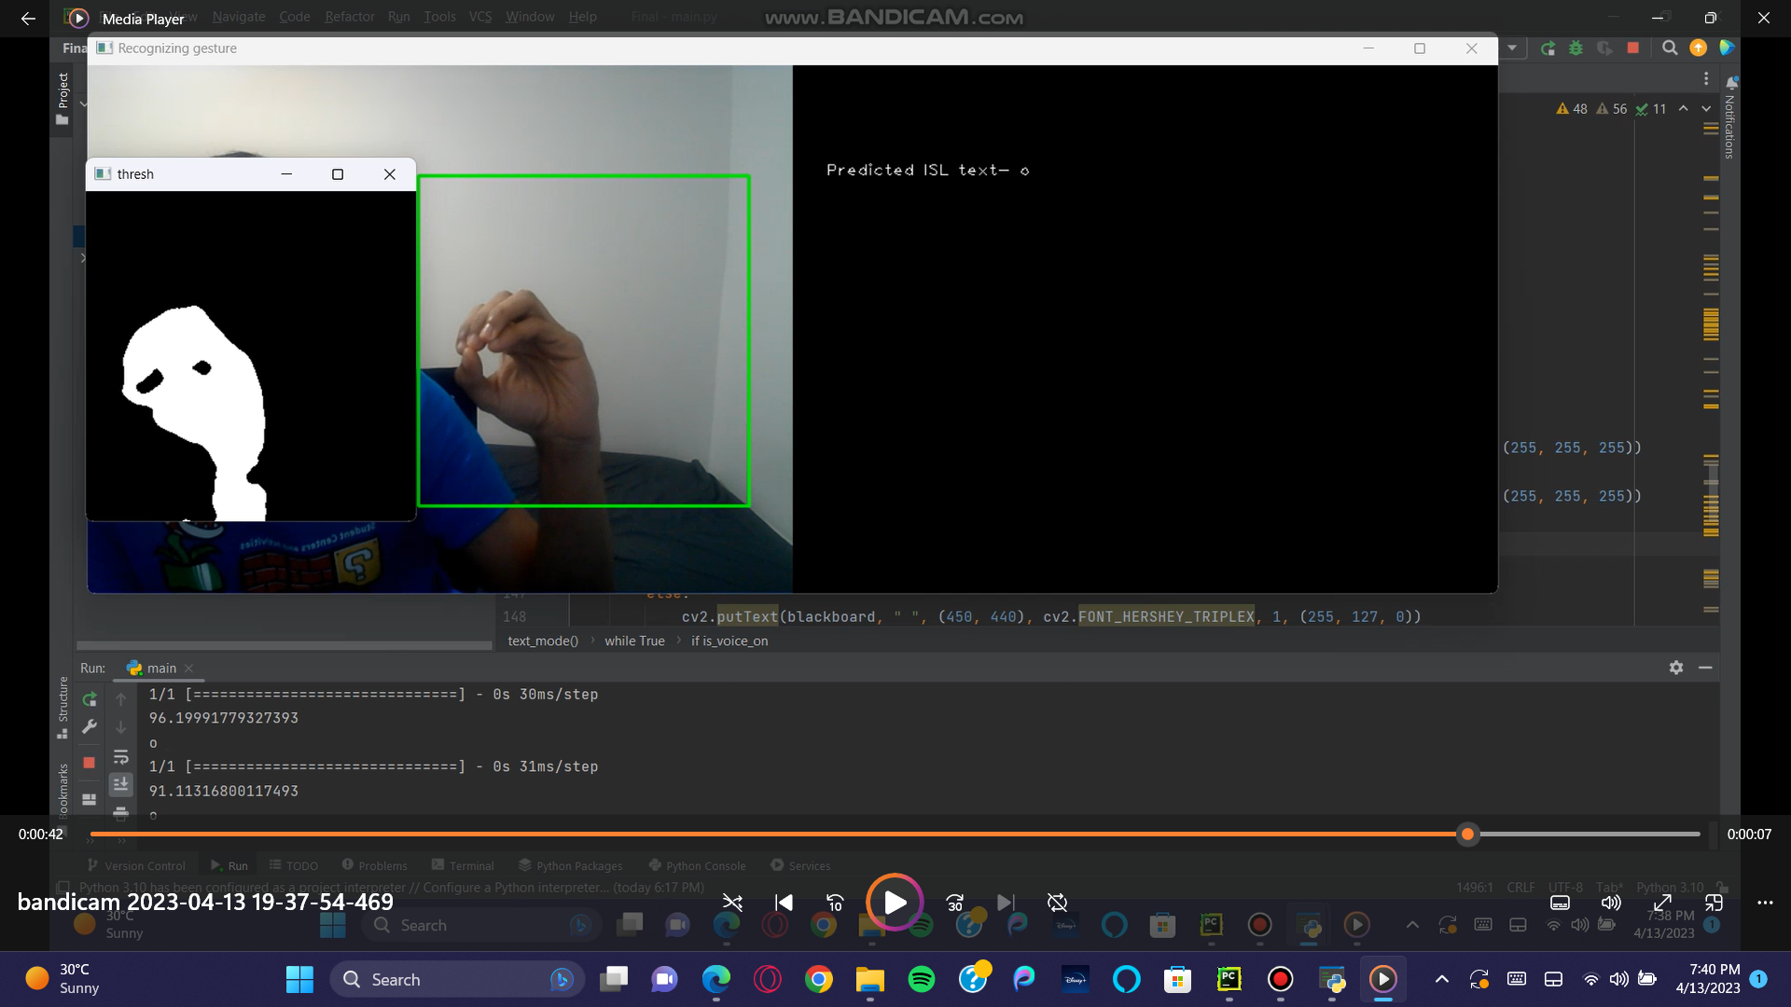
Output - ISL - Letter o

Slide 26
What did we learn?
Through this project, we learned about the importance of sign language recognition for individuals with hearing disabilities and the challenges involved in creating a system that can recognize different sign language systems.
We also learned about the various techniques involved in developing a sign language recognition tool, including image processing, feature extraction, and machine learning algorithms.
We also understood the various intricacies involved in building a CNN model that would fit our data just right, without too much bias or variance.
We learned how a CNN model processes an input image to classify it into a desired type.

Slide 27
Conclusion
In the future, we hope to expand our project to recognize a wider range of signs and include more sign language systems to make communication more accessible for individuals with hearing disabilities worldwide.
We believe that our project can have a positive impact on the lives of individuals with hearing disabilities, enabling them to communicate more effectively and independently.

